Slide 1
A Single-GPU LM for Linux Documentation
By Nikolaos Sopiadis

Slide 2

Motivation - Problem
Inconvenient
Linux is:
Free
Customizable
Hard for beginners
But it is Documented!
Man-pages (or tldr)
Wikis and Forums
Videos?

Slide 3

Motivation - Solution
Ask someone your questions and get a quick answer
Use available resources
Locally trained language model

Slide 4
Related Work
The obvious answer: Chat GPT
Ancestors: GPT4, GPT3, GPT2
(Generative Pre-trained Transformer)
The not so obvious answer: BERT
(Bi-directional Encoder Representations from Transformer)
GPT
BERT
What
What
…
is
…
is
Linux?
Linux?

Slide 5
Related Work
CRAMMING: TRAINING A LANGUAGE MODEL ON A SINGLE GPU IN ONE DAY
The similarities
Consumer hardware (rtx 2080ti vs rtx 3060)
The differences
Dataset
Time
Model size

Slide 6
Training Data
Gathered from:
Archwiki
Man-pages
Linux related Wikipedia articles
Linux kernel documentation
Gathering good data is difficult!
Data preprocessing:
Removed unrelated entries
Removed non english text
File size > 1kb
90% training - 10% validation
~170 MiB training data
~ 17 MiB validation data

Slide 7
Feeding the Data
Scheduler:
Streams data (whole dataset not saved in memory)
Reads files in 1 MiB chunks
Tokenizes, buffers, emits fixed 128-token sequences
Tokenization:
BertTokenizerFast by Hugging Face
Dynamic 80/10/10 masking:
25% positions masked
80% replaced with mask
10% random token
10% unchanged
Multiple epochs (10) due to smaller dataset size

Slide 8
Model Parameters Estimation
Cramming :
Model: 12‐layer, ~110 M parameters
Data: ~3.3 billion tokens
TPP(Token Per Parameter): ~3.3 B / 110 M = 30 tokens/param
Chinchilla scaling law:
Optimal TPP = ~20 tokens/param
My model:
6 layers
Assuming average token length = ~3.2 bytes/token
Data: ~170MiB = ~50 M tokens/epoch
Epochs: 10
Assuming optimal TPP of 20 tokens / param
We get ~25M parameters
Decided to test 2 models: 25 M parameters and 13 M parameters

Slide 9
Model Architecture
Decoder-only Transformer
6 layers, hidden=256/512, heads=4, FFN=1024/2048 -> Total ~13/25 M parameters
Sinusoidal positional embeddings
No Q/K/V biases
No non-linear output projection

Slide 10
Model Architecture - Transformer Block
Each block follows the “pre-norm” style:
LayerNorm
Multi-Head Self-Attention
Residual Add
LayerNorm
Feed-Forward Network (FFN)
First Linear Layer
GELU Activation
Dropout
Second Linear Layer
Residual add

Slide 11
Training Setup and Optimizations
Training Setup:
Micro-batch: 96 tokens with dynamic accumulation
Linearly ramp acc_steps from 21 / 10 to 85 / 40 (reaches max at 60%)
Optimizer: AdamW (β₁=0.9, β₂=0.98,
ε=1e-12, weight decay=0.01)
LR schedule: cosine decay with 10% warm up
Optimizations:
Mixed precision floating point
No measurable difference
Pytorch kernel parameters and network JIT compilation
~10% performance increase
Dropping q/k/v biases
Another ~10% performance increase

Slide 12
Differences between attempts
Aspect | First Attempt | Second Attempt
Model Size | 6×256 hidden, 4 heads, FFN=1024 -> ~13 M params | 6×512 hidden, 4 heads, FFN=2048 -> ~25 M params
Dropout | 0.10 | 0.05
Clip gradient | 0.5 | Linear ramp from 1.5 to 0.5
Learning Rate | Peak lr = 3e-4, warmup 10% | peak_lr = 1e-3, warmup 10%
Batch Accumulation | Linear ramp from 21 to 85 micro-batches (2 K to 8 K tokens) | Linear ramp from 10 to 40 micro-batches (1 K to 4 K tokens)

Slide 13
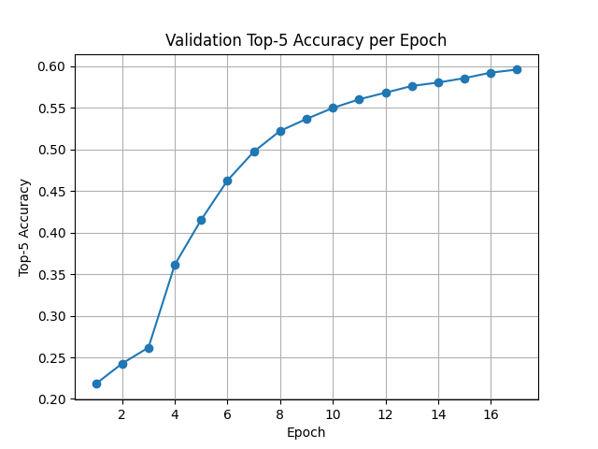
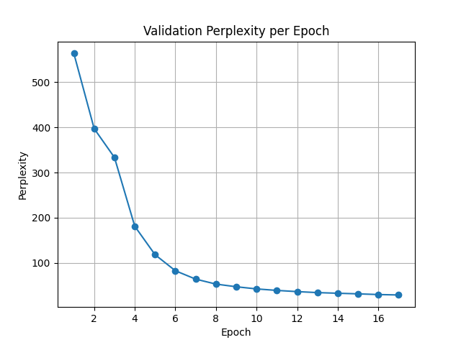
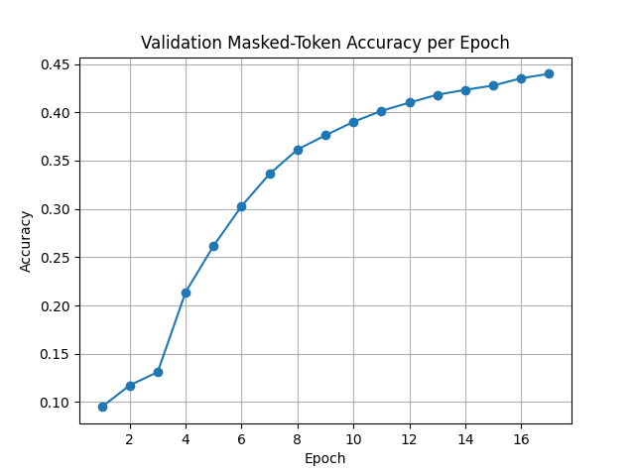
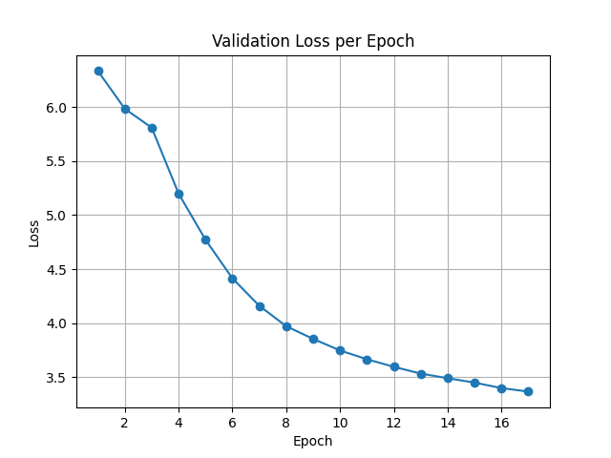
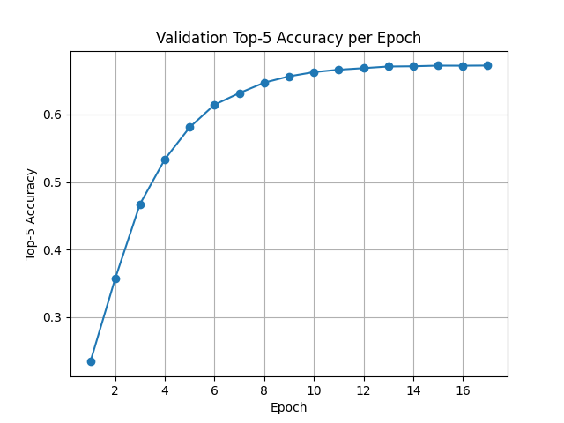
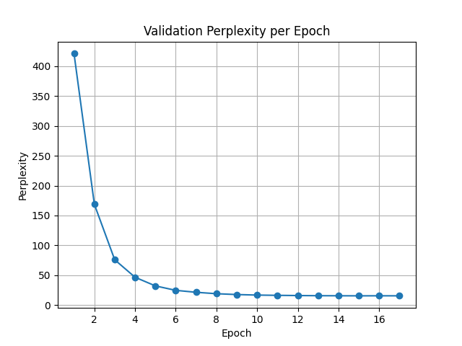
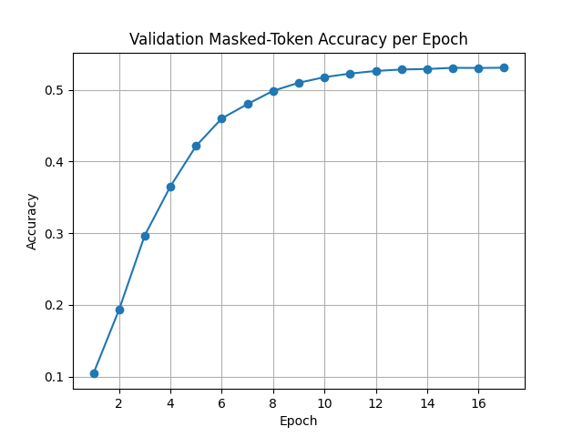
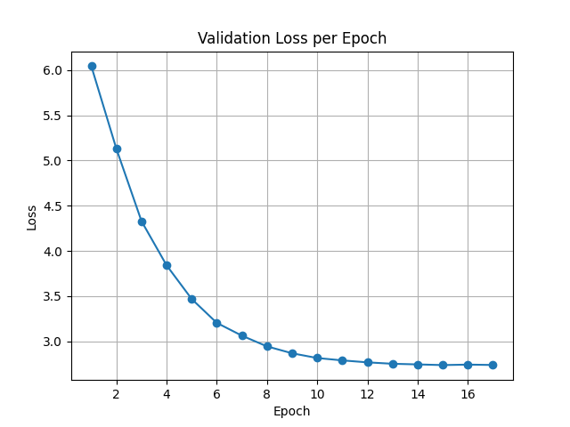
Training Curves - 13M (top), 25M (bottom)

Slide 14
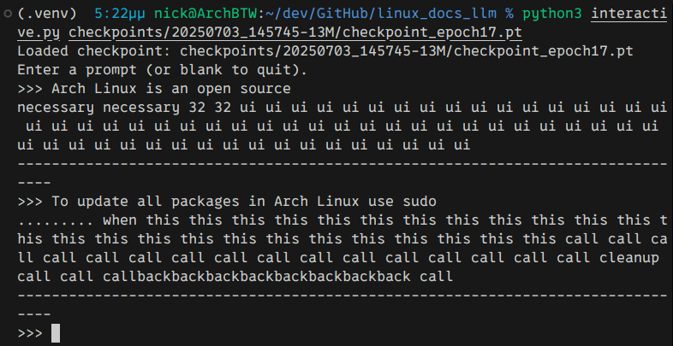
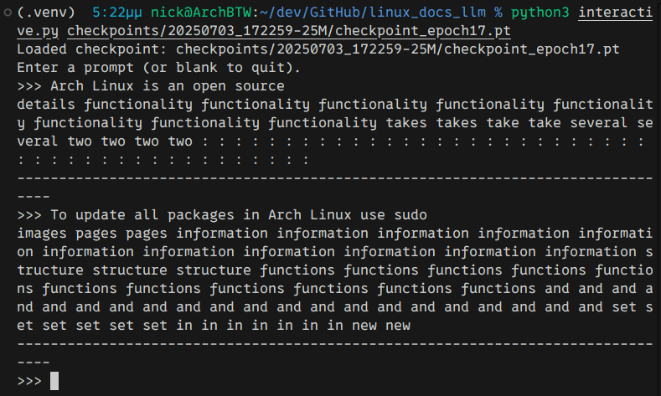
Samples
13M Parameters Model
25M Parameters Model

Slide 15
Possible Improvements
Evaluation:
The 2nd more aggressive model had seemingly marginally better performance
The performance gain seems to come from the one common variable between the two: The limited dataset
Metrics plateau but slowly increase. This points to undertraining
Trained on low quality dataset
Possible Improvements:
Larger dataset
Cleaner, learning friendly dataset
More aggressive learning
Pre-train on a more general dataset and fine-tune on the more specific dataset

Slide 16
Thank You!
Feel free to contact me for any questions
Email: nsopiadis@tuc.gr
Github: https://github.com/NikolaosSopiadis/linux_docs_llm

